Slide 1
Stepping up your testing game The Test Pyramid

Slide 2


Overview & Level Setting– Where we were
Limited test coverage
Many-one: Testers-to-Developer
Top Heavy Testing
2300 BDD tests
Minimal refactoring
Agile Maturity Level 1
Code first, test later mentality
Escaped sprint defect

Slide 3


Overview & Level Setting– Where we are
Team structure – SM PO Developer (Developers perform Analyst Tester role)
Code coverage minimum 80% (Sonar Cube)
Simple process of test first mindset – Test scenario and map to test type
Exploratory testing
Demo to PO by developers

Slide 4
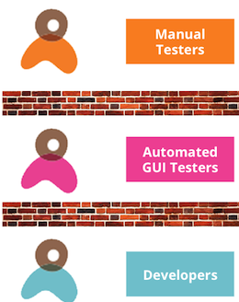
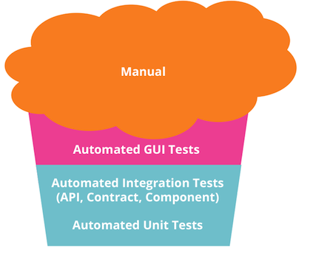

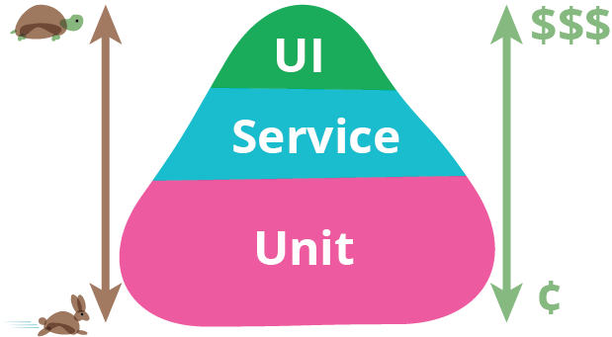
Test Automation
Organization Roles
Testing Cupcake
Test Pyramid

Slide 5
Test Pyramid – Integrate Upwards [minimize overlap]
Identify where tests go
Each layer should be independent and testing from a differing perspective
Each layer should be focusing on integration and not re-testing

Slide 6
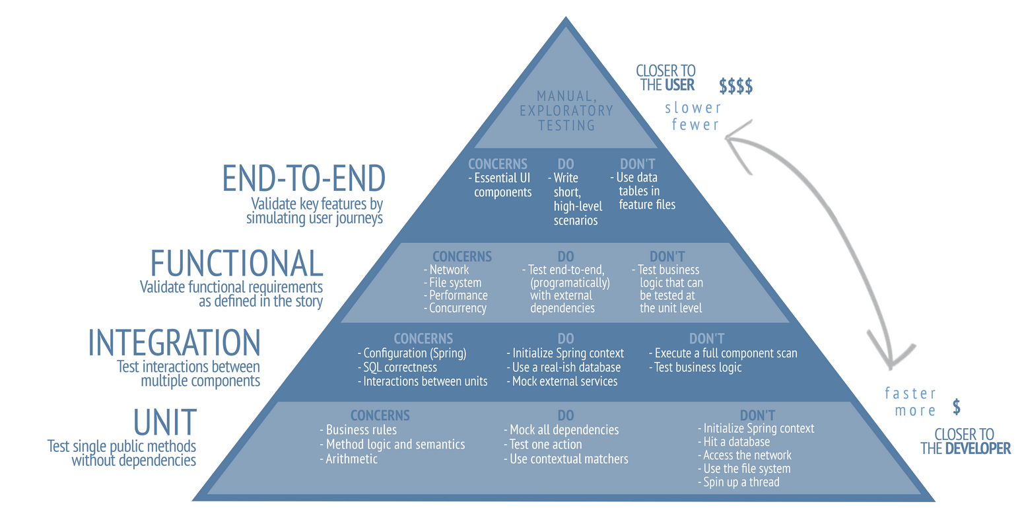
Test Pyramid – Java

Slide 7
UNIT
Code Quality
Test Framework
TDD
Test Design

Slide 8
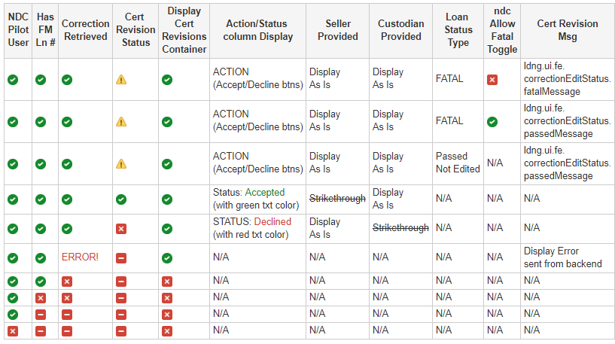
Test Design
Code Quality
Test Framework
TDD
UNIT
Test Design Example:
Identify all data points/Entities
Identify all processes associated with flow
Identify expected output
Create all permutations
Validate and Optimize
Perform Team Test Reviews!!

Slide 9
Test Design
Code Quality
Test Framework
TDD
UNIT – Boundary test
Testing Technique Example:
Identify equivalence partitions
Identify boundaries

Slide 10
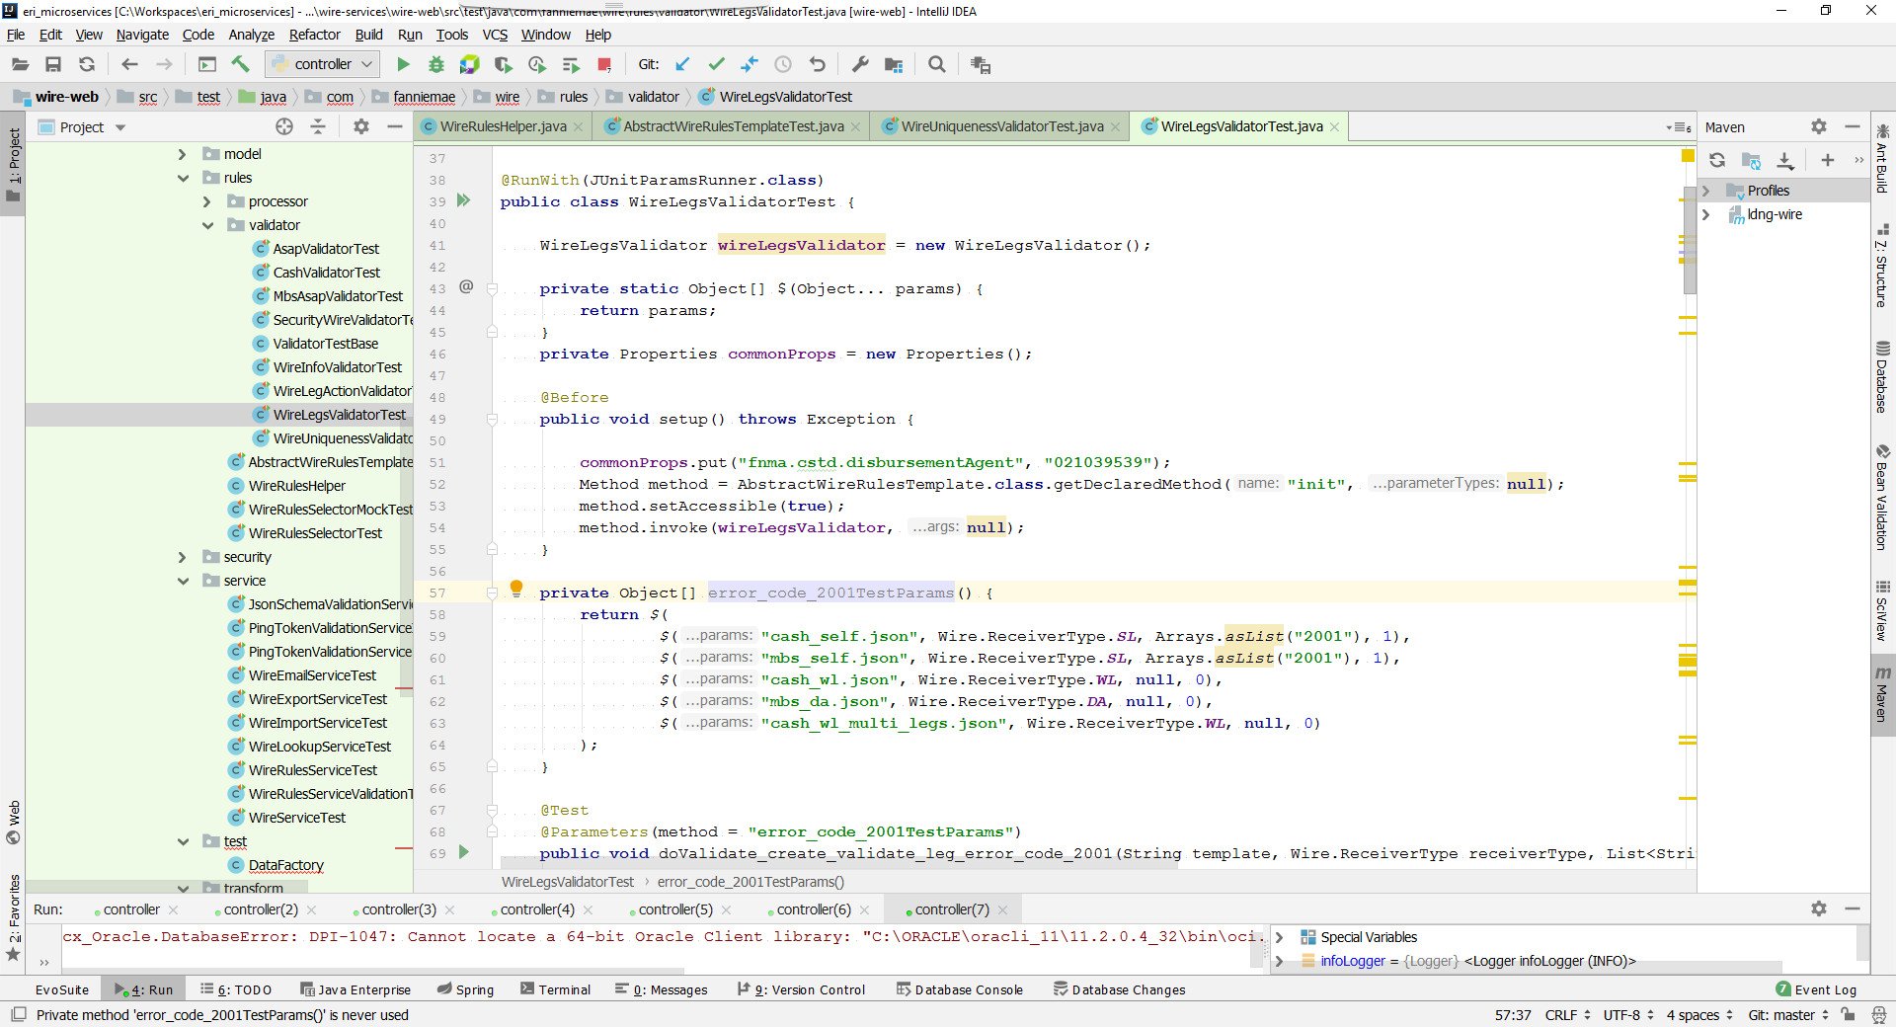
Test Design
Code Quality
Test Framework
TDD
UNIT - Parameterize

Slide 11
Test Design
Code Quality
Test Framework
TDD
UNIT
Mocks Repo
Data Repo/
Providers
Helpers / Pre/Post Setters
Utils / Common
Jasmine
Junit5
PowerMock/
Mockito
AssertJ
Karma

Slide 12
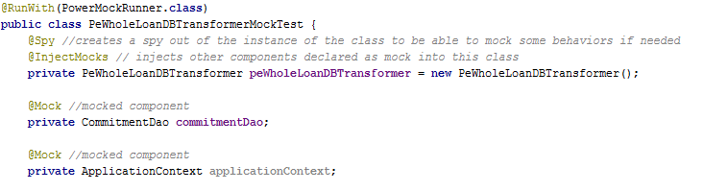
Test Design
Code Quality
Test Framework
TDD
UNIT – Mock 1 of 2

Slide 13
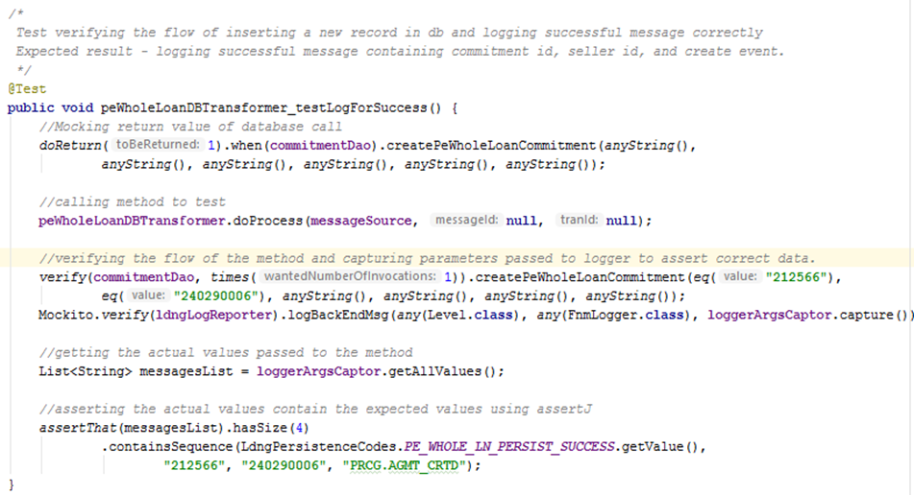
Test Design
Code Quality
Test Framework
TDD
UNIT – Mock 2 of 2

Slide 14
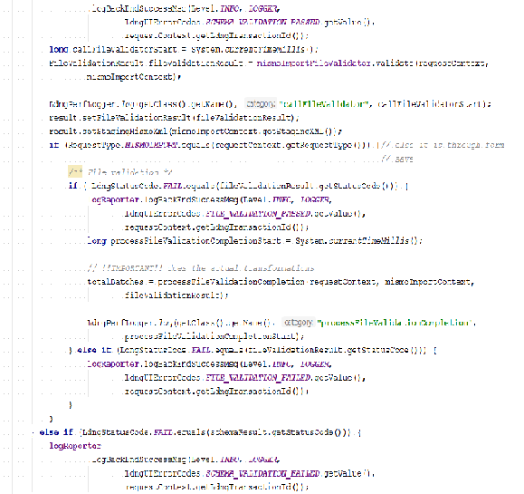
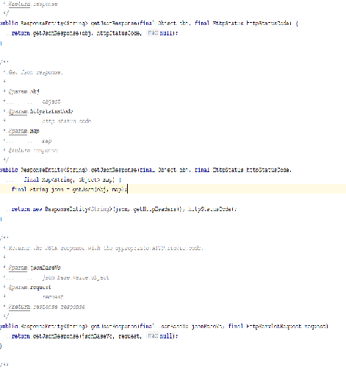
Test Design
Code Quality
Test Framework
TDD
UNIT – TDD 1 of 2
Code written without using TDD
Code written using TDD
Modularized Code
Assumption Based Programming
Refactor on green only

Slide 15
Test Design
Code Quality
Test Framework
TDD
UNIT – TDD 2 of 2
TDD
Requirement – Round Interest rate to 2 decimal places
Write - Test
Run - Fail
Write - Code
Run- Pass
Write – Code
Run - Pass
Break - Code
Run- Pass
Write- Test
Dev then Test
Requirement – Round Interest rate to 2 decimal places
Oh No! Test wasn’t testing what it should!!
Yikes! TDD
Anti Pattern
Refactor On Green
Requirement – Add 15 product
Use template pattern - Refactor
Run - Pass
Repeat
TDD
Notes:
Steps
1. Uncomment step 1 in MortgageCalcTDDTest
1. Uncomment step 1 in MortgageCalc and run tests = FAIL
2. Uncomment step 2 in MortgageCalc and rerun tests = PASS
4. Uncomment step 4 in MortgageCalc
5. Uncomment step 5 in MortgageCalcCodeFirstTest and run the test = PASS
6. Uncomment step 6 in MortgageCalcTDDTest and run the tests = FAIL
7. Uncomment step 7 in MortgageCalc and rerun tests in MortgageCalcTDDTest = PASS
8. Uncomment step 8 in _30yrMortgageCalcTDDTest and run tests = FAIL
9. Uncomment step 9 in _30yrMortgageCalc and run tests = PASS
10. Uncomment step 10 in _15yrMortgageCalc and run tests = PASS

Slide 16
Front-End Unit Testing Tools
Test Design
Code Quality
Test Framework
TDD
UNIT
Jasmine
A behavior-driven development framework for testing JavaScript Code
Dependency free and doesn’t require a DOM
Karma
A test runner for writing and running unit tests while developing Angular apps
Increases developer productivity
Angular Testing Utilities
Create a test environment for the application code under test
Used to test interactions

Slide 17
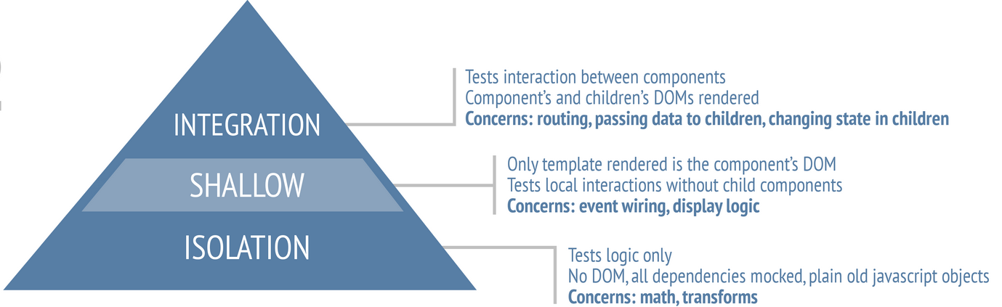
Test Design
Code Quality
Test Framework
TDD
UNIT

Slide 18
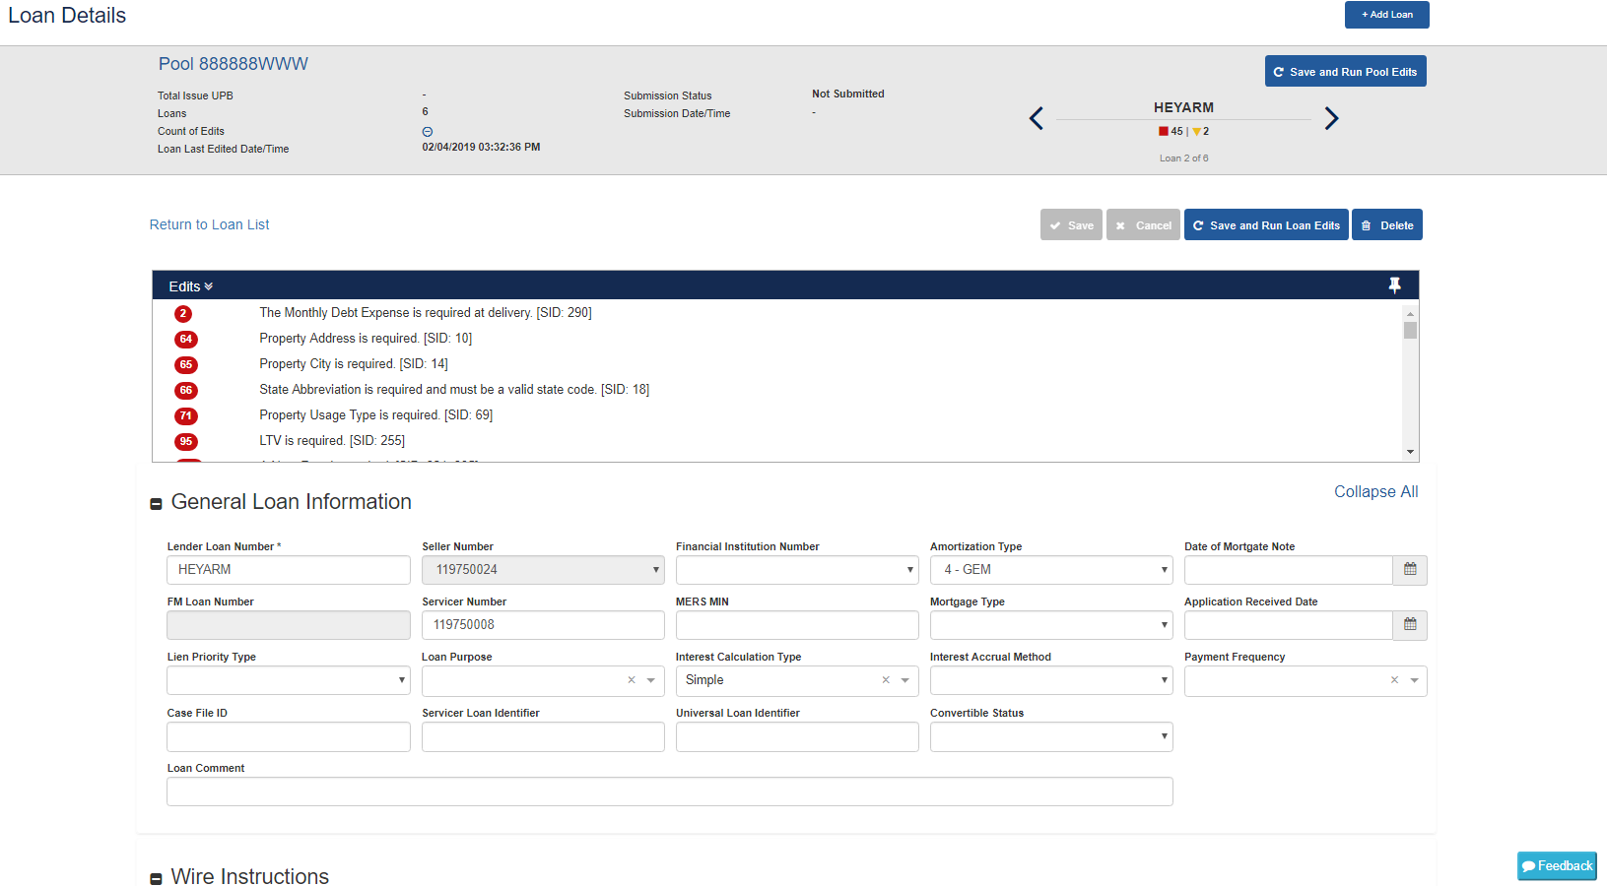
Carousel
Toolbar
Edits
Loan Details

Slide 19
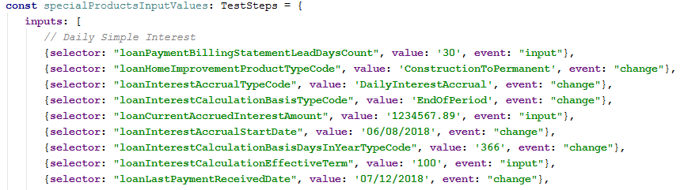
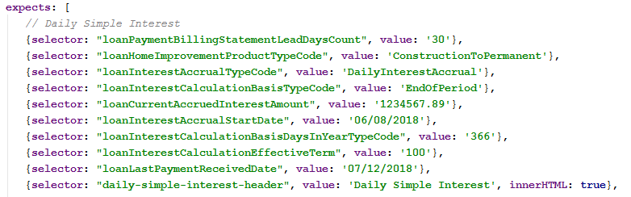
Parameterized Tests with Jasmine
Test Design
Code Quality
Test Framework
TDD
UNIT
Allows the execution of one test with different input and output values
Reduces testing code redundancies
Makes dealing with edge cases easy

Slide 20
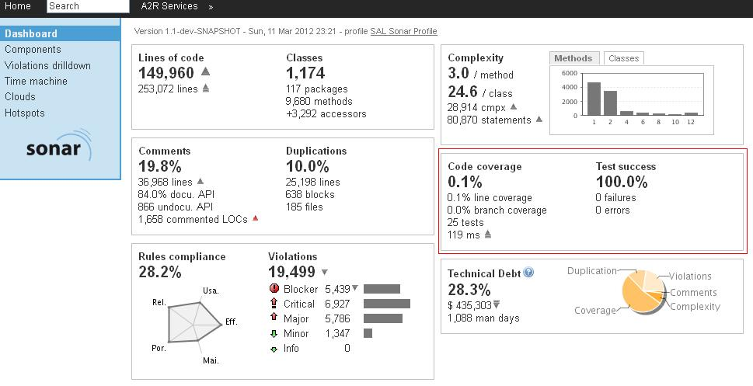
Code Quality
Test Framework
TDD
Test Design
UNIT
Quality build gates
Leverage tools for code coverage:
SonarCube (Left)
JaCoCo
CLM
What’s Next
PIT – Mutation Testing (Exploring)
MockK

Slide 21
Code Quality
Test Framework
TDD
Test Design
UNIT
Test Design Example:
Identify all data points/Entities
Identify all processes associated with flow
Identify expected output
Create all permutations
Validate and Optimize
Perform Team Test Reviews!!

Slide 22
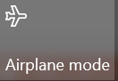
Integration
What is an integration test?
Basic rule of thumb is that if,
A test uses the database
A test uses the network
A test uses an external system (e.g a queue, or a mail server or external service)
A test reads/writes or performs other I/O
… then it is an integration test and not unit test

Slide 23
Integration
Do’s
Consider the cost vs. benefit of each test
Use intention revealing test names
Use production like data
Exercise every integration path
Limit verifications purely to the end state
Component
Interface Mock/Injection
External Service
Controller
Service
Another Component
DAO
Don’t
Write an integration test when a unit test suffices
Have too many data variations for same path
Test more than one thing
Heavily test business logic with integration testing
Leave the system in a bad/unknown state
DB
Different Integration Paths

Slide 24
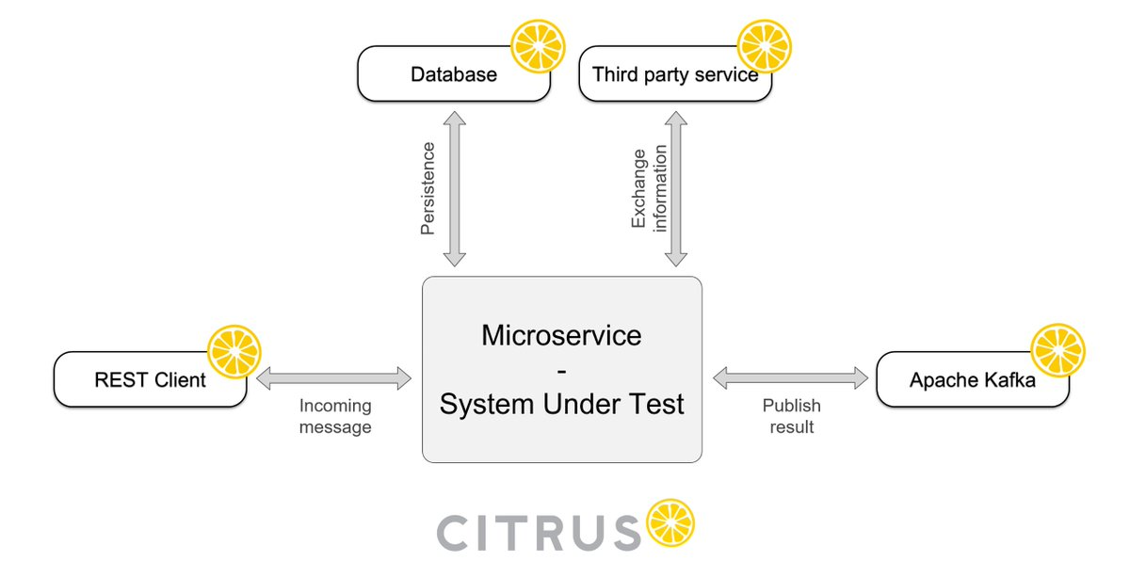
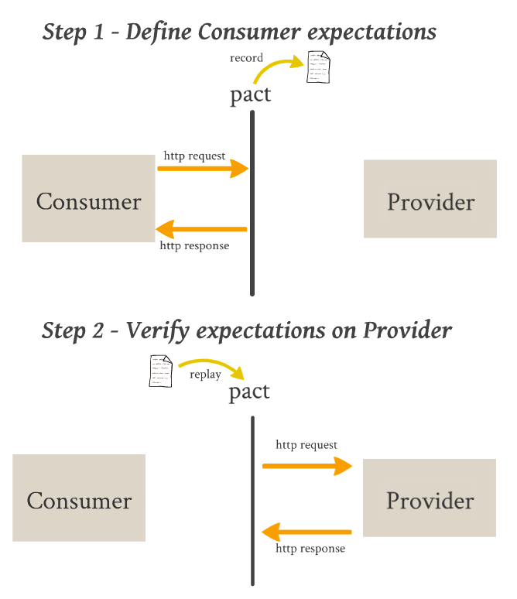
Integration – Next Steps

Slide 25
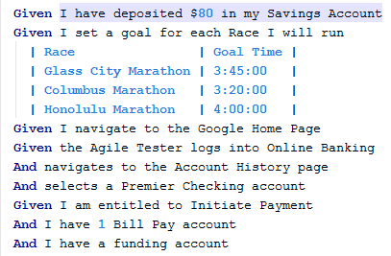
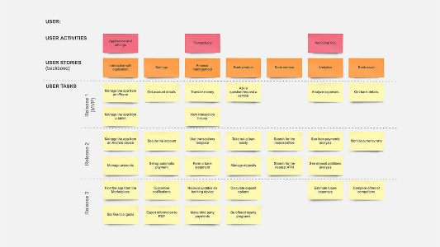
End-to-End
User – Journey Feature Files
User - Journey
Expresses
User
Experiences
SUT (Front-End)
GlueCode
Mimics User
Selenium
Glue Code
SUT (Back-End)
Interfaces
Data Store
System Under Test
BDD Framework

Slide 26
Test Example – Old
End-to-End
Feature: Pool Correction Functionality Background: Given user changes seller and commitment numbers in input file as per user profile And user cleans up imported data from database for the following deal sets: | LH3793C | | XN6420T | And user logs in as "default" user And we generate an import file using "goldenFiles/General_MBS_FRM.xml" as the mismo template with "2" dealset and "1" deal per dealset and: | xpath | value | | //DEAL_SET[1]/POOL/POOL_DETAIL/PoolIdentifier | XN6420 | | //DEAL_SET[1]/POOL/POOL_DETAIL/PoolSuffixIdentifier | T | | //DEAL_SET[2]/POOL/POOL_DETAIL/PoolIdentifier | LH3793 | | //DEAL_SET[2]/POOL/POOL_DETAIL/PoolSuffixIdentifier | C | When "default" user imports generated mismo file using REST endpoint And user verifies the following transaction types exist: | Eligibility Response Processed | And setup loans in pools to the following: | poolNumber | loanNumber | action | | XN6420T | * | submit | And user navigates to Pool Detail Page for the Pool "XN6420T" Then user verifies following fields on "Pool Details" page: | fieldType | fieldLabel | fieldKey | expected | | text | header_submissionStatus | header_submissionStatus | Submitted | When user clicks "Run Edits" on the "Pool Details" page ## following step verifies trandId in db and pulls it to set it in shared data context And user runs the following query to verify results in table "TRAN,XMLTABLE('/Requests' PASSING TRAN.LN_DLRY_RQST_XML COLUMNS REQUEST_TYPE PATH 'RequestType')" : | queryBlock | columnName | columnValue | | SELECT | TRAN_ID | NOT NULL | | WHERE | LN_DLRY_ELIG_RQST_LVL_TYP | PackageEdit | | WHERE | SELR_ID | SellerID(1) | | WHERE | DL_SET_ID | RQ2231T | | WHERE | REQUEST_TYPE | RunEligibility | | WHERE | REC_CREN_DTTM | withInLastMinutes(1) | And user verifies the following transaction types exist: | Eligibility Response Processed | Then user verifies following fields on "Pool Details" page: | fieldType | fieldLabel | fieldKey | expected | | text | header_submissionStatus | header_submissionStatus | Data Modified After Submission | When user navigates to Pool Detail Page for the Pool "XN6420T" Then user verifies following fields on "Pool Details" page: | fieldType | fieldLabel | fieldKey | expected | | div | poolCorrectionTab | poolCorrectionTab | displayed | When user executes "FN_CBRSupdateQuery_PoolCorrection" query on DB where: | columnName | columnValue | | mbs_pool_id_sfx_id | XN6420T | When user clicks "poolCorrectionTab" on the "Pool Details" page And user clicks "Add" on the "Pool Details" page And user waits for "2" seconds @import @eligibility @uivalidation @poolcorrections @pooldetail @mbs @deprecated Scenario: 16_Submit_CorrectionsButton Then user verifies following fields on "Pool Details" page: | fieldType | fieldLabel | fieldKey | expected | | div | XPATH_POPUP_DIALOG | XPATH_POPUP_DIALOG | displayed | | header | addCorrectionHeader | XPATH_POOL_CORRECTION_HEADER | displayed | And user enters values for following fields on "Pool Details" page: | fieldNickName | fieldValue | | authAddPC | fillerAuth |

Slide 27
Test Example – New
End-to-End
Feature: MBS pool Scenario: Update critical fields post submission Given a pool is already submitted And lender modifies critical fields Then validate the lender is prompted to revise wiring instructions And lender revises wiring instructions and submits the pool corrections Then validate that the pool corrections event is published And validate that the DDF transmission file is created

Slide 28
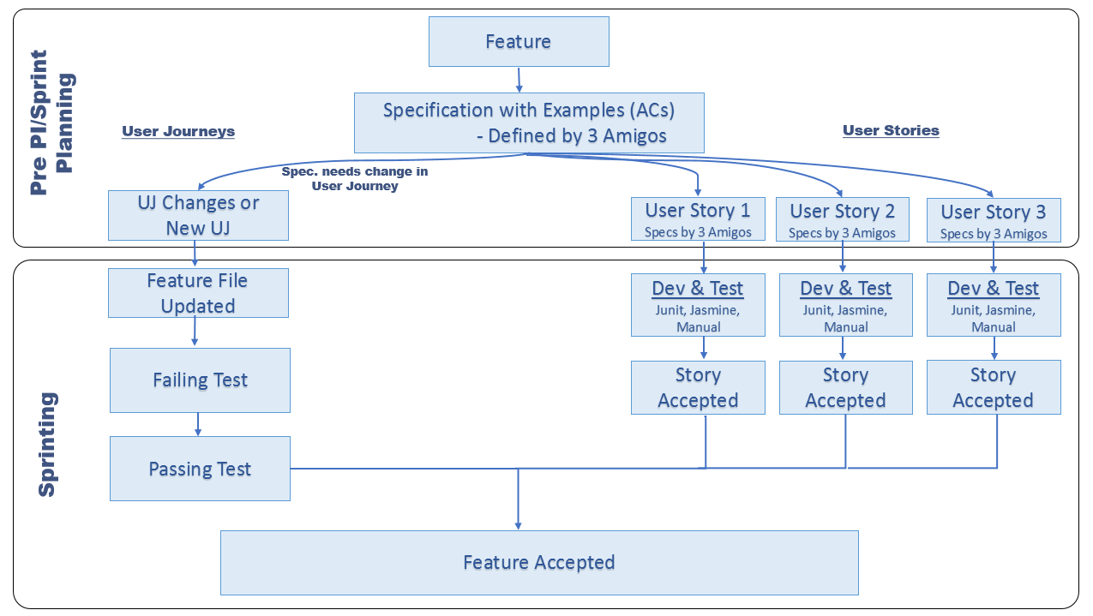

End-to-End
Feature Acceptance Approach

Slide 29
End-to-End
Overview & Level Setting– Where we are
2016 - 2018
90% reduction in # tests
98% reduction in runtime
Multiple executions per day
4 attempts
2 dedicated staff to transition the test suite to Agile Teams

Slide 30
Exploratory
Museum Tour
Model Tour
Tourist Tour
Guided Tour
Chaotic Tour

Slide 31
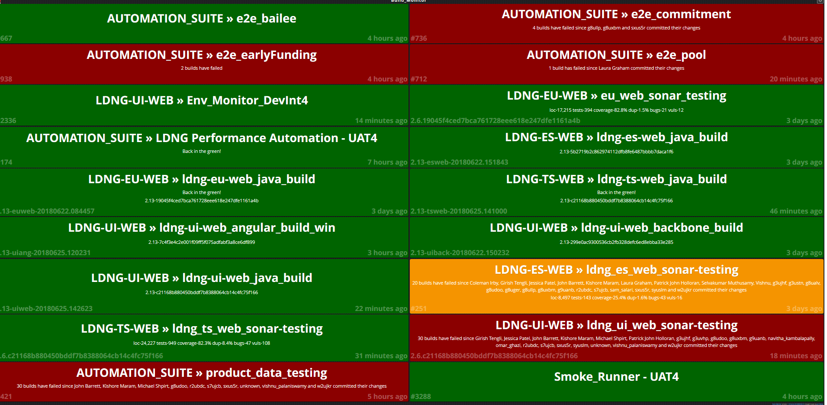

Continuous Integration and Continuous Delivery
Junit deployment pre-hook
Environment Shakeout Suite
Integration Testing
In-Sprint Performance Testing
BDD Context Driven Testing
Sonar and Metrics Checks
Runtime Product Based Testing
Failure Speaker Alarm/Emails

Slide 32
Questions?

